Slide 1
TypeScript Basics
Hardeep Kaur Dhalla

Slide 2
Objectives
Practice JavaScript basics
Operators
decision structures, control structures etc.
Type conversion
Functions
Arrays

Slide 3
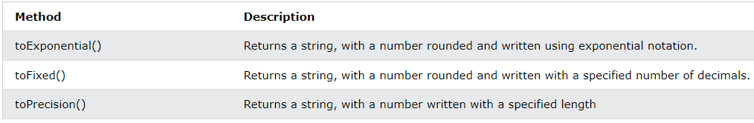
Type conversion
Numbers to Strings
String() can convert numbers to strings.
toString() can convert numbers in base 10 to strings.
toString(2) can convert binary numbers to strings.
toString(8) can convert octal numbers to strings.
toString(16) can convert hexadecimal numbers to strings.

Slide 4
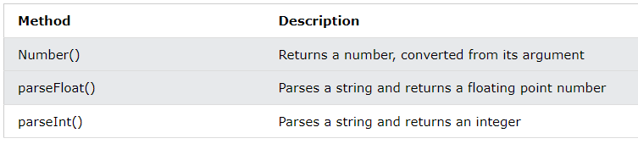
Type conversion
String to Numbers
Number fxn only parses string.
Last two methods will ignore trailing non-number characters in string.

Slide 5
Working with Arrays
Array indexes are zero-based.
Array literal
let names = [“Harry", “Danny", “Adam"];
console.log(names[0]);

Slide 6
Iterating over an array using for loop
Using for loop
for(let i = 0; i < names.length; i++){
console.log(“Name is " + names[i]);
}

Slide 7
Array methods
https://www.w3schools.com/jsref/jsref_obj_array.asp

Slide 8
Named functions
The syntax for a named function
function functionName (parameters) {
// statements that run when the function is executed
//return statement if value is returned
}
function calculateTax ( subtotal, taxRate ) {
let tax = subtotal * taxRate;
tax = parseFloat( tax.toFixed(2) );
return tax;
}

Slide 9
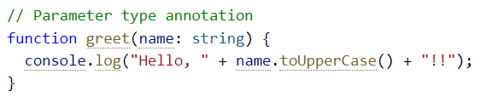
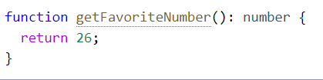
Functions
Parameter Type Annotations
Return Type Annotations
you don’t need a return type annotation because TypeScript will infer the function’s return type based on its return statements.

Slide 10
An anonymous function
Syntax:
var variableName = function(parameters) {
// statements that run when the function is executed
}

Slide 11
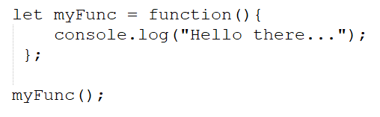
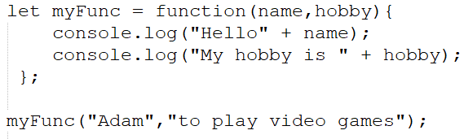
An anonymous function
Example1
Example2:

Slide 12
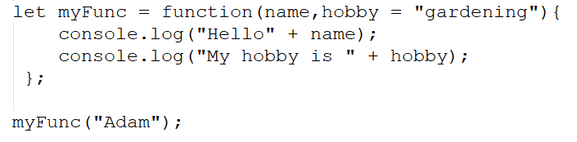
Default parameters

Slide 13
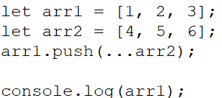
Using the spread operator
Array can be used a function argument or combined with other arrays.

Slide 14
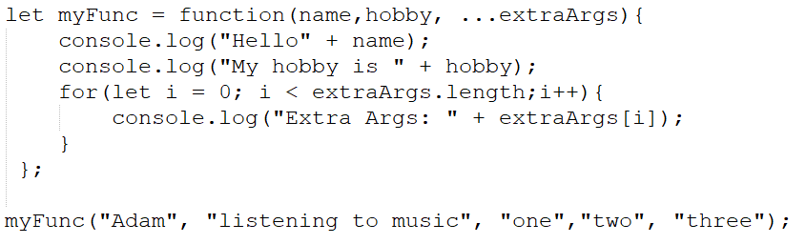
Rest parameters
All values passed must be of the same type.
Any non-rest parameter should come before the rest parameter.

Slide 15
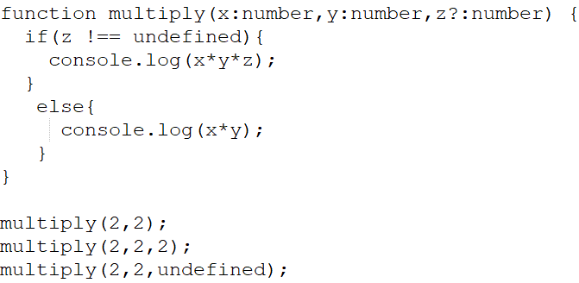
Optional Parameters
A parameter can be made optional by appending a question mark to its name.
A required parameter cannot follow an optional parameter. Users can provide undefined value for the optional parameters.

Slide 16
Arrow functions
Arrow functions were introduced in ES6.
let multiply = (a, b) => a * b;
Rules:
If the function has only one statement, and the statement returns a value, you can remove the brackets and the return keyword
If you have zero or more than 1 parameters, you pass them inside the parentheses
if you have only one parameter, you can skip the parentheses as well.
let multiply = a => a * 2;

Slide 17
For reference
https://www.typescriptlang.org/

